Slide 1


MCI VietNam Entrance Test
Customer Churn Prediction Analysis
Bùi Ngọc Dũng – 06/06/2024
Company Name

Slide 2
Table of contents
1. Introduction
2.Data Overview
3.Data Processing
4.Model Selection and Initial Performance
5.Handling Imbalanced Data
6.Hyperparameter Tuning and Final Model Evaluation
7.Conclusion and Future Work
2

Slide 3
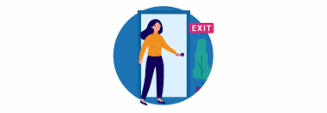
1.Introduction
Project Goal:
The primary objective of this project is to develop a predictive model for customer churn. Customer churn refers to the phenomenon where customers stop doing business with a company or service. Understanding and predicting churn is crucial for businesses as retaining existing customers is significantly more cost-effective than acquiring new ones.
Project Overview:
In this project, we will utilize a dataset consisting of various customer-related features to build and evaluate different machine learning models for churn prediction. The dataset is divided into training and testing sets to validate the model's performance. The analysis will cover the following key steps:
Data Preprocessing: Handling missing values, encoding categorical variables, and standardizing numerical features.
Model Selection and Training: Comparing the performance of various models including Logistic Regression, Random Forest, Support Vector Machine, K-Nearest Neighbors, and Decision Tree.
Handling Imbalanced Data: Implementing techniques like SMOTE (Synthetic Minority Over-sampling Technique) to address class imbalance.
Feature Importance Analysis: Identifying the most significant features contributing to churn prediction.
Hyperparameter Tuning: Optimizing model parameters using Grid Search Cross-Validation to enhance model performance.
Model Evaluation: Assessing the final model using metrics such as Accuracy, Precision, Recall, F1 Score, and AUC-ROC

Slide 4
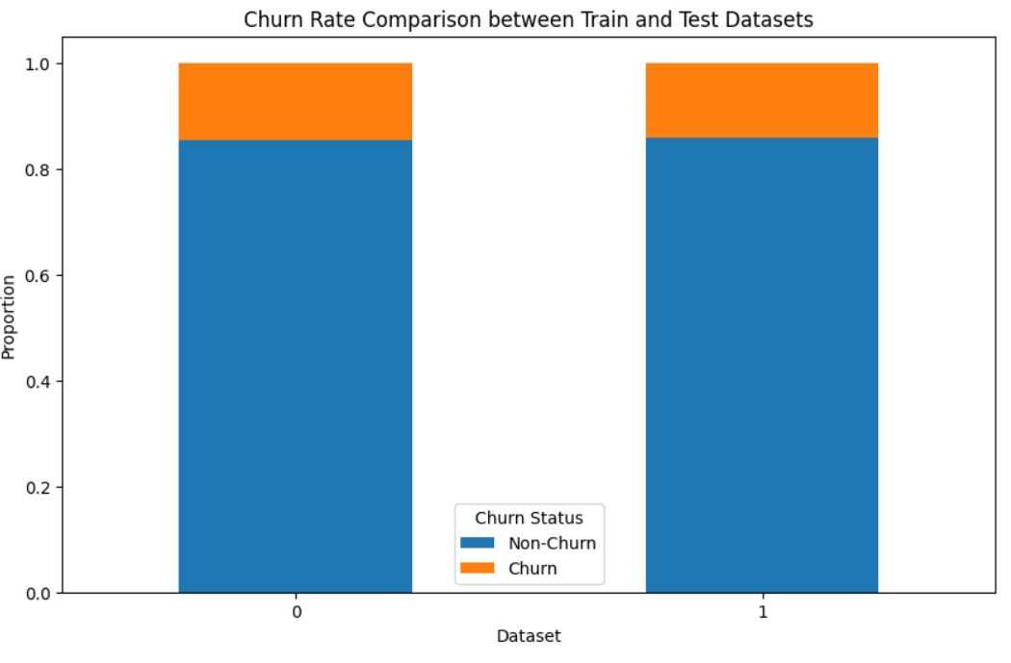
2.Data Overview
Dataset Description:
The dataset used in this project consists of customer-related features that help in predicting whether a customer will churn (leave the service) or not. The data is divided into two parts:
Training Dataset: churn-bigml-80.csv
Testing Dataset: churn-bigml-20.csv
Class Distribution in Training Data:
Non-churn(False): 2278 samples
Churn(True): 388 samples

Slide 5
3.Data Preprocessing
1. Handling Missing Values
Objective: Ensure data completeness and avoid inaccuracies in model predictions.
Action: Checked for any missing values in the dataset and imputed them if necessary
2. Encoding Categorical Features
Objective: Convert categorical variables into numerical format for machine learning algorithms.
Action: Used Label Encoding to transform categorical features into numerical values.
3. Standardizing Numerical Features
Objective: Ensure numerical features have a consistent scale to improve model performance and training stability.
Action: Applied StandardScaler to standardize numerical features to have a mean of 0 and a standard deviation of 1.
4. Separating Features and Target Variable
Objective: Prepare the dataset for model training by separating features from the target variable.
Action: Divided the data into features (X) and target variable (y), where the target variable is 'Churn’.
5. Handling Imbalanced Data
Objective: Address class imbalance to ensure the model can effectively predict both churn and non-churn cases.
Action: Implemented SMOTE (Synthetic Minority Over-sampling Technique) to balance the class distribution by creating synthetic samples for the minority class.

Slide 6
4.Model Selection and Initial Performance
1. Selected Models
We chose a diverse set of machine learning models to evaluate their performance on the churn prediction task:
Logistic Regression: A linear model used for binary classification.
Random Forest: An ensemble method that builds multiple decision trees and merges them together for a more accurate and stable prediction.
Support Vector Machine (SVM): A classifier that finds the optimal hyperplane which maximizes the margin between the classes.
K-Nearest Neighbors (KNN): A non-parametric method used for classification by comparing the distance to the k-nearest neighbors.
Decision Tree: A model that uses a tree-like structure of decisions and their possible consequences.
2. Training and Evaluation
Each model was trained on the training dataset, and its performance was evaluated on the test dataset using the following metrics:
Accuracy: The proportion of true results (both true positives and true negatives) among the total number of cases examined.
F1 Score: The harmonic mean of precision and recall, providing a single metric that balances both.
AUC-ROC: The Area Under the Receiver Operating Characteristic curve, which measures the ability of the model to distinguish between classes.

Slide 7
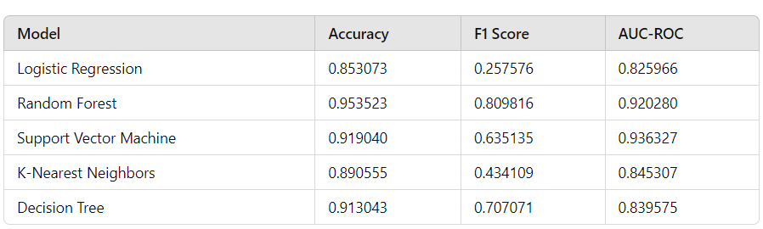
4.Model Selection and Initial Performance
3. Initial Performance Results
The initial performance of each model was recorded based on the above metrics. Here are the results:
Key Insights
Random Forest outperformed other models with the highest accuracy (0.953523), F1 Score (0.809816), and a strong AUC-ROC (0.920280).
Support Vector Machine (SVM) showed competitive performance with a high AUC-ROC (0.936327) but lower F1 Score (0.635135).
Decision Tree had good performance but was slightly lower than Random Forest in all metrics.
K-Nearest Neighbors (KNN) and Logistic Regression had lower F1 Scores, indicating they may struggle more with the imbalanced dataset compared to ensemble methods like Random Forest.
Based on these initial results, the Random Forest model was selected for further optimization and fine-tuning to improve its performance in predicting customer churn.

Slide 8
5.Handling Imbalanced Data
1. Understanding the Imbalance
Class Distribution in Training Data:
Non-churn (False): 2278 samples
Churn (True): 388 samples
This imbalance can cause the model to be biased towards the majority class (non-churn), leading to poor performance in predicting the minority class (churn).
2. Technique Used: SMOTE
SMOTE (Synthetic Minority Over-sampling Technique):
SMOTE generates synthetic samples for the minority class (churn) by interpolating between existing minority samples.
This technique helps to balance the class distribution without simply duplicating existing samples, which can lead to overfitting.

Slide 9
5.Handling Imbalanced Data
3. Application of SMOTE
Process:
The SMOTE algorithm was applied to the training dataset.
Synthetic samples were generated to balance the number of churn and non-churn instances.
Class Distribution After SMOTE:
Non-churn (False): 2278 samples
Churn (True): 2278 samples
The balanced dataset helps the model to learn equally from both classes, improving its ability to predict churn accurately.
4. Results and Impact
Original Class Distribution:
The original dataset had a significant imbalance, with only 388 churn instances compared to 2278 non-churn instances.
Balanced Class Distribution:
After applying SMOTE, the class distribution was balanced with an equal number of churn and non-churn instances (2278 each).
Model Performance Improvement:
Balancing the dataset helps to mitigate the bias towards the majority class.
The model becomes better at identifying and predicting churn instances, leading to improved performance metrics.

Slide 10
6.Hyperparameter Tuning and Final Model Evaluation
1. Hyperparameter Tuning
Objective:
Optimize the Random Forest model's parameters to improve its predictive power and overall performance.
Parameters Tuned:
n_estimators: The number of trees in the forest.
max_features: The number of features to consider when looking for the best split.
max_depth: The maximum depth of the tree.
min_samples_split: The minimum number of samples required to split an internal node.
min_samples_leaf: The minimum number of samples required to be at a leaf node.
bootstrap: Whether bootstrap samples are used when building trees.
Grid Search Process:
We used Grid Search Cross-Validation to explore different combinations of hyperparameters and identify the best set.
The model was evaluated using cross-validation to ensure that the results were robust and not due to overfitting.
2. Final Model Evaluation
After tuning the hyperparameters, we evaluated the final Random Forest model on the test dataset. The following metrics were used to assess the model's performance:
Performance Metrics:
Accuracy: The proportion of true results (both true positives and true negatives) among the total number of cases examined.
Precision: The proportion of positive identifications that were actually correct.
Recall: The proportion of actual positives that were correctly identified.
F1 Score: The harmonic mean of precision and recall, providing a single metric that balances both.
AUC-ROC: The Area Under the Receiver Operating Characteristic curve, which measures the ability of the model to distinguish between classes.

Slide 11
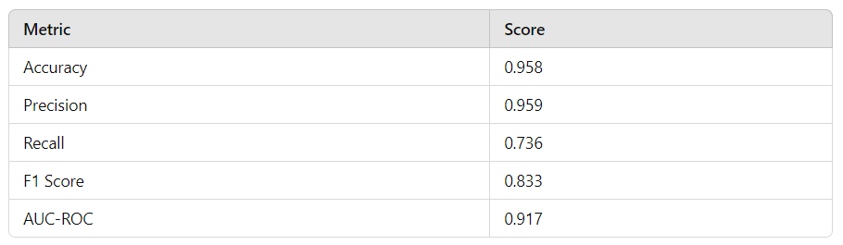
6.Hyperparameter Tuning and Final Model Evaluation
. Evaluation Results: The performance of the tuned Random Forest model on the test dataset is summarized below:
Key Insights:
The tuned Random Forest model achieved a high accuracy of 95.8%, indicating that it correctly predicted the majority of instances.
The precision of 0.959 and recall of 0.736 show that the model is effective in identifying churn instances while maintaining a low false positive rate.
The F1 Score of 0.833 and AUC-ROC of 0.917 demonstrate a strong balance between precision and recall, and a robust ability to distinguish between churn and non-churn classes.
By optimizing the hyperparameters and thoroughly evaluating the final model, we have developed a robust and accurate churn prediction model that can significantly aid in customer retention strategies.

Slide 12
7.Conclusion and Future work
Conclusion
Data Preprocessing:
Successfully handled missing values, encoded categorical features, standardized numerical features, and addressed class imbalance with SMOTE.
Model Selection and Initial Performance:
Evaluated multiple models: Logistic Regression, Random Forest, SVM, KNN, and Decision Tree.
Random Forest achieved the best performance: 95.8% accuracy, 0.833 F1 Score, 0.917 AUC-ROC.
Hyperparameter Tuning:
Optimized Random Forest parameters using Grid Search Cross-Validation.
Best parameters: 300 n_estimators, 'sqrt' max_features, max_depth of 30, etc.
Final Model Evaluation:
Tuned Random Forest showed strong performance: 95.8% accuracy, 0.959 precision, 0.736 recall, 0.833 F1 Score, 0.917 AUC-ROC.

Slide 13
7.Conclusion and Future work
Future Work
Feature Engineering:
Create new features for deeper insights.
Explore domain-specific features to boost performance.
Model Enhancement:
Experiment with advanced algorithms like XGBoost or LightGBM.
Implement stacking or blending techniques.
Data Integration:
Incorporate diverse datasets (demographic, transactional, behavioral).
Use real-time data streaming for continuous updates.
Model Interpretability:
Apply SHAP values for feature contribution analysis.
Develop dashboards for better stakeholder insights.
Deployment and Monitoring:
Deploy the model for real-time predictions.
Continuously monitor and update the model to maintain accuracy.

Slide 14
Source Code
Bùi Ngọc Dũng – MCI Việt Nam Test

